Slide 1
Life in the colony
The roles men and women performed in colonial America were sharply divided.
Men mainly worked outdoors. They planted and tended the crop, chopped firewood, cared for the livestock and butchered meat.
Women generally worked indoors. They prepared the food, cleaned the house, laundered the clothes, wove cloth, spun thread and sewed.
Men and women were responsible for raising the children. Women cared for the infants and men played an active role with the older children. Children were always needed to work on the farm.

Slide 2
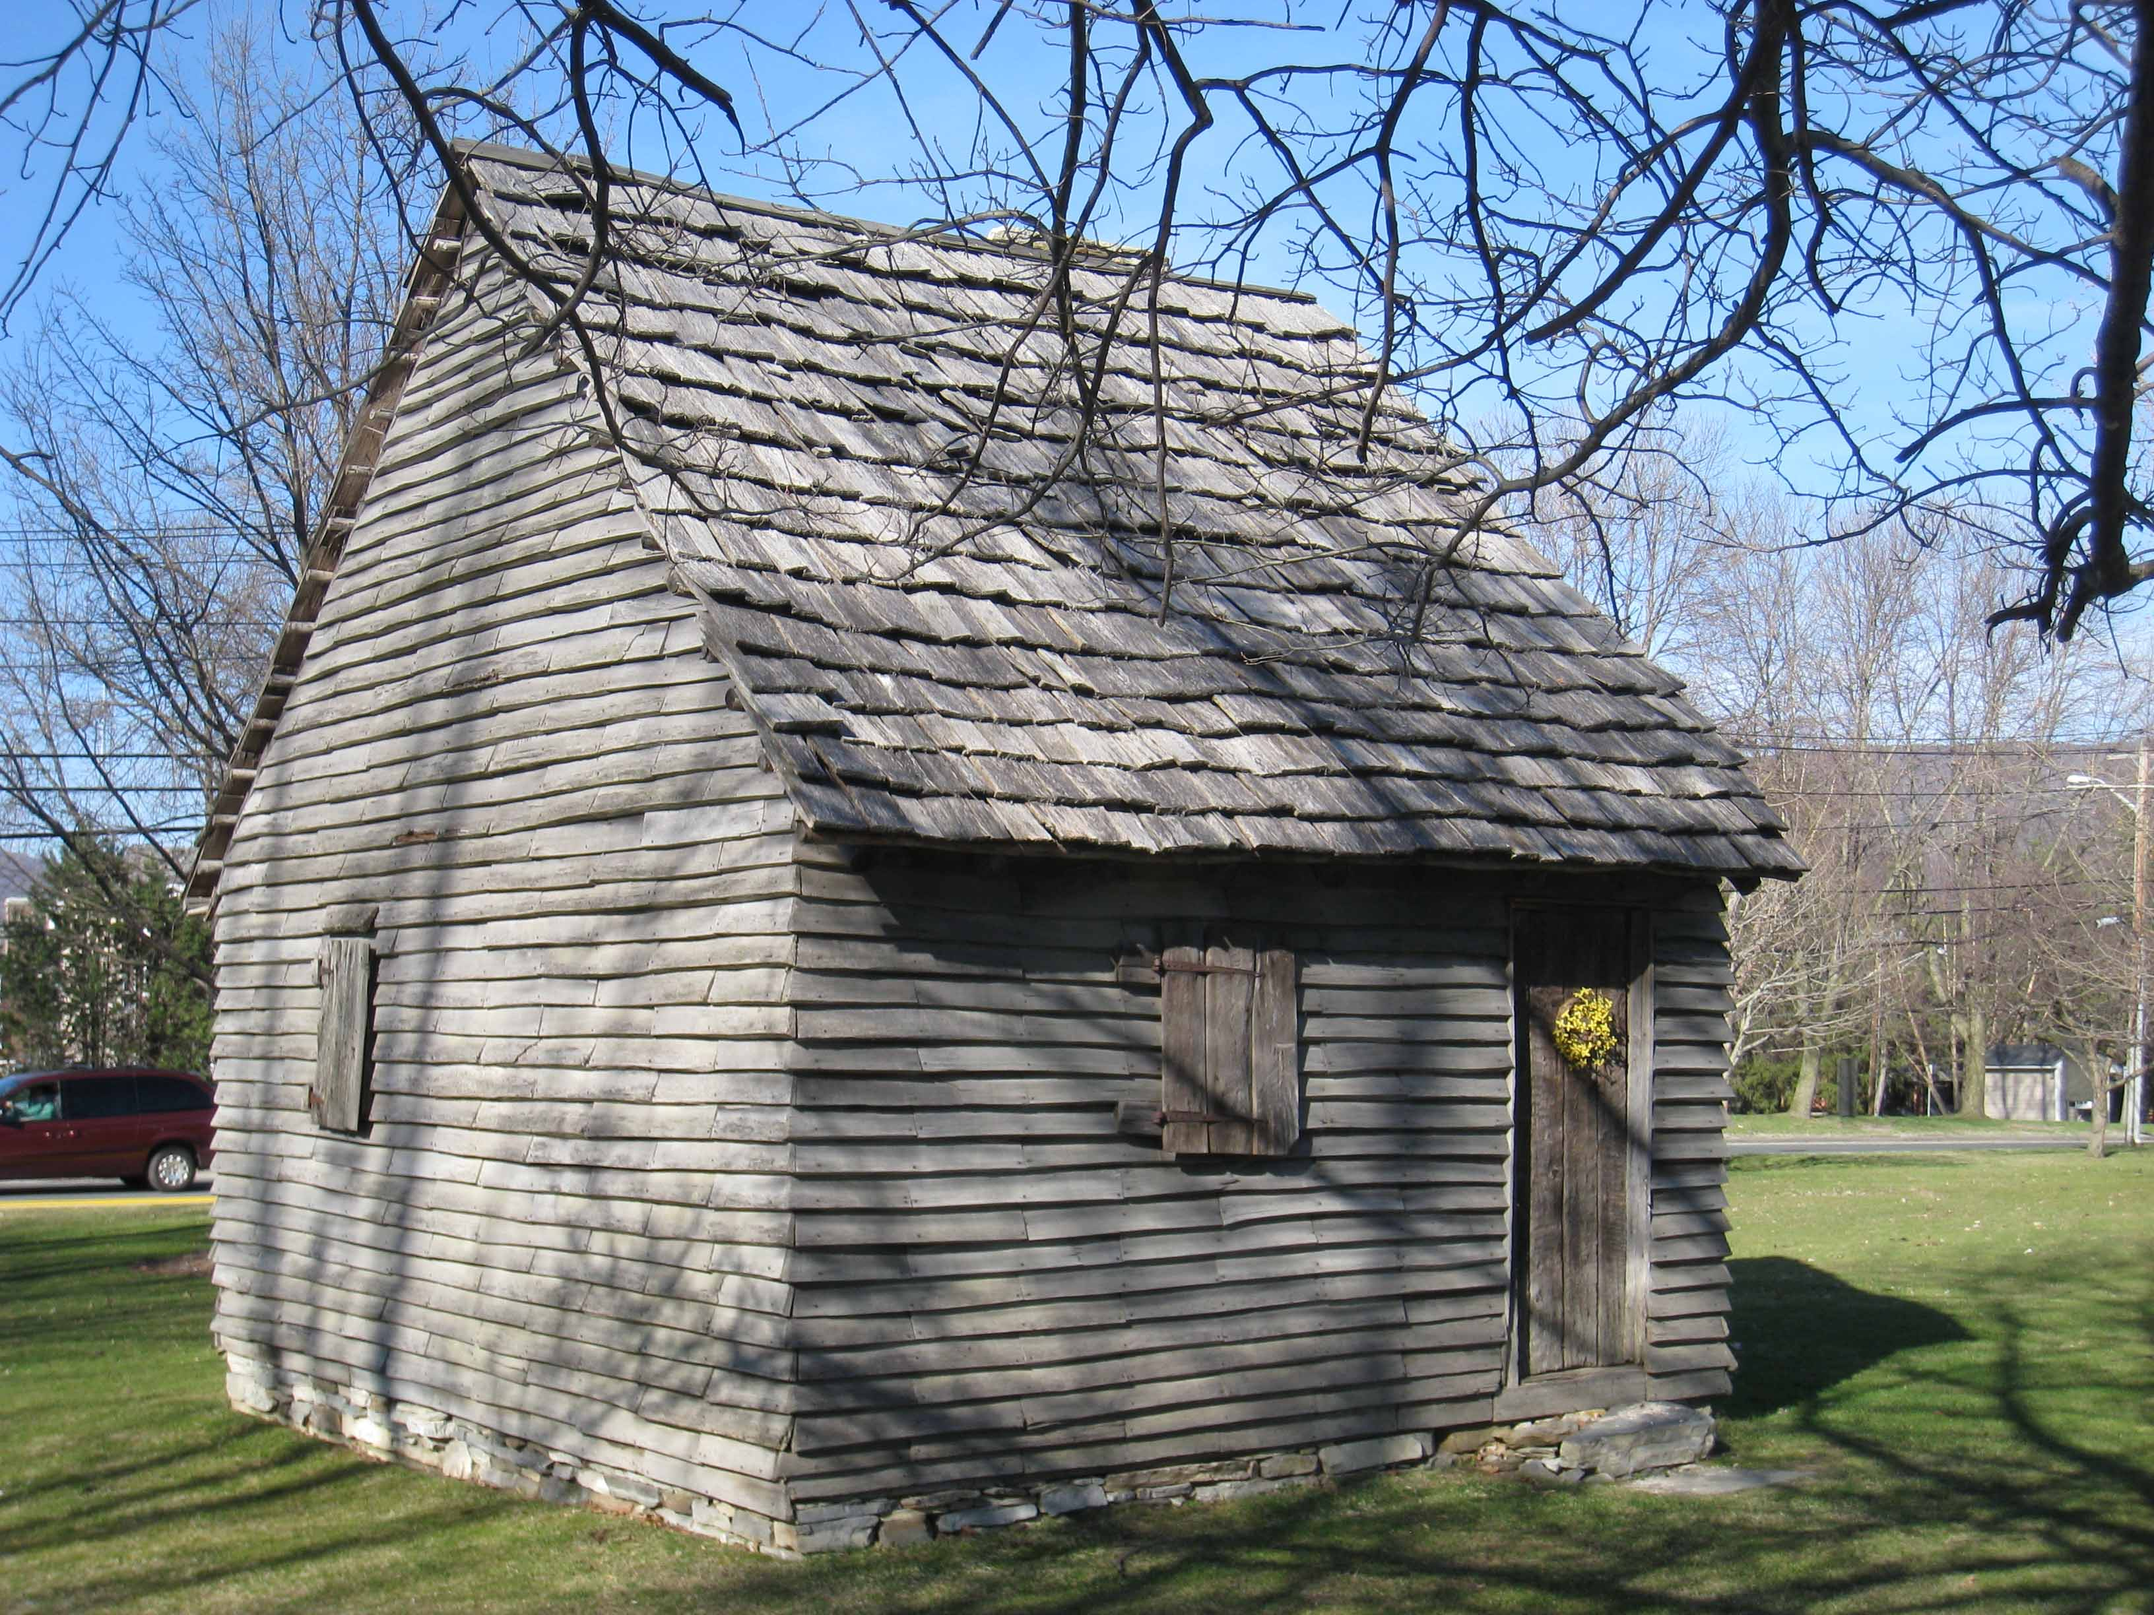
Colonial homes
During the colonial period, most houses in North Carolina were poorly made using wood, clay and stone and were one or two room homes.

Slide 3
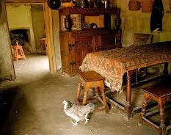
Colonial Homes
Many of the homes had dirt floors, mud and stick chimneys and wooden shutters.

Slide 4
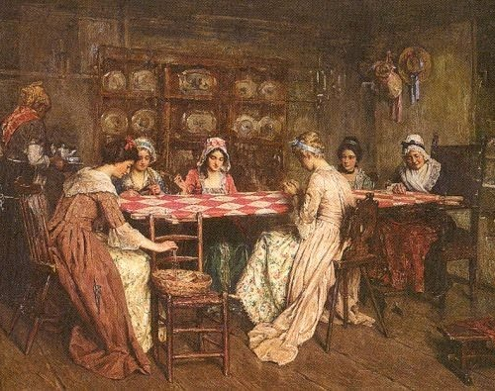
Socializing
People took opportunities to socialize any chance they got. Men would often socialize by attending court, gathering with the militia or grinding grain at a mill. Women would socialize around such ordinary chores as husking corn, making quilts or spinning thread. Women also gathered to help with childbirth.

