Slide 1
North Carolina

Slide 2
King Charles I of England

Slide 3
The Heath Charter

Slide 4
Settlement in Carolina

Slide 5
Turmoil in England

Slide 6
Reward for faithful service

Slide 7
Question #1

Slide 8
The Eight Lords Proprietors

Slide 9
Carolina Charter of 1663

Slide 10
Fundamental Constitution of 1669

Slide 11
Fundamental Constitution of 1669

Slide 12
Counties

Slide 13
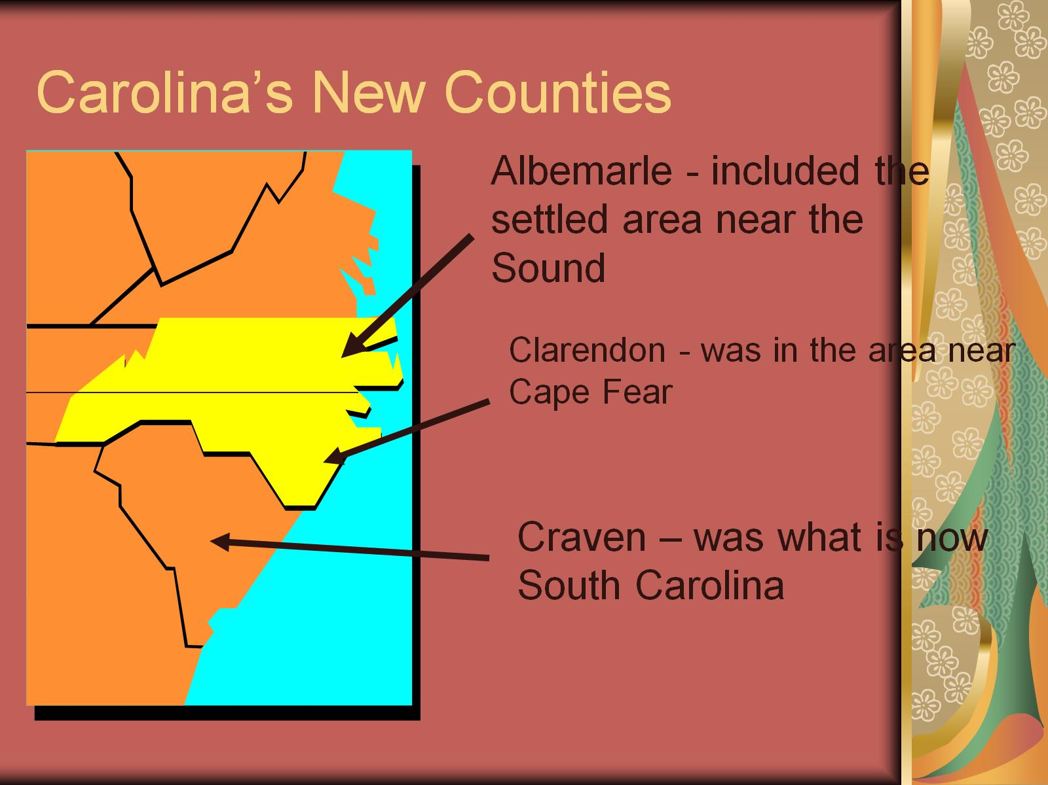
Carolina’s New Counties

Slide 14
Question #2

Slide 15
Carolina Government

Slide 16
Power of Governor

Slide 17
Power of Governor

Slide 18
Powers of the Assembly

Slide 19
Carolina Assembly

Slide 20
Political Parties in Albemarle

Slide 21
Political Parties in Albemarle

Slide 22
Culpeper’s Rebellion

Slide 23
Culpeper’s Rebellion

Slide 24
Insert Culpeper’s Rebellion

Slide 25
North Carolina grew slowly because:

Slide 26
Questions #3-4

Slide 27
Questions #5-6

Slide 28
Cary’s Rebellion

Slide 29
Cary’s Rebellion

Slide 30
North Carolina’s first towns

Slide 31
Tuscarora War

Slide 32
Tuscarora War

Slide 33
Pirates

Slide 34
North Carolina and Pirates

Slide 35
North Carolina Pirates

Slide 36
Division of the Carolina colony

Slide 37
Division of the Carolina colony

Slide 38
Early Social Order

Slide 39
Settlement of the Piedmont

Slide 40
Insert Life in the colony

Slide 41
Groups that settled North Carolina

Slide 42
Highland Scots

Slide 43
Highland Scots

Slide 44
Scotch-Irish

Slide 45
Germans

Slide 46
Moravians

Slide 47
Moravians

Slide 48
Africans

Slide 49
Granville District

